Slide 1
GSKY server: setup and WMS service Animated display of the process flow
build_all.sh
GSKY
TerriaJS
MAP
Source: GSKY_OWS_Server.pptx
Details: GSKY_OWS_Server.docx
Pre-requisites:
1. Setup a virtual machine
2. Setup GSKY server (build_all.ppsx)
3. Browse via TerriaJS
It will take approximately 7 minutes to watch this demo.
If too fast or too slow, then open the *.pptx for controlled slideshow.
Open the *.pptx and use the ‘Animations | Preview’ to view each slide.
NOTE: The full content can only be viewed by animation, even in the *.pptx
The slide show will begin in 5 seconds !

Slide 2
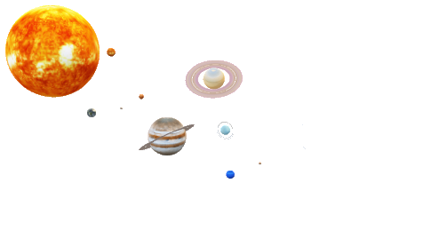
GSKY server: setup and WMS service High Level Process Flow of the Program Code
func generalHandler()
case GetMap
Get http query
Call func serveWMS
Get tiles’ data
Send to the web
Sanity checks
Find layer index
Prepare request for MAS
Get data from MAS server
Five major functions and several packages:
init(); generalHandler(); serveWCS(); serveWMS(); serveWPS();
The WMS service is described here.
This is a quick overview. Details in: GSKY_OWS_Server.docx
func init()
func serveWMS()
Serve The Data
Define variables
Check files and configuration
Build config map
Run GSKY server as a daemon
- case GetCapabilities
- case GetFeatureInfo
- case DescribeLayer
- case GetMap
Validate the data
Check zoom level
Prepare the data
Write out to the web
Next: Details

Slide 3
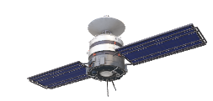
ows.go: func init()
Main function that sets up the GSKY server
Initialise variables, check file paths and create a configuration map.
Start the server and listen on port 80.
In-built mechanism to dissociate from the shell if it exits.
Define Variables
Error = log.New(os.Stderr, "OWS: ", log.Ldate|log.Ltime|log.Lshortfile)
Info = log.New(os.Stdout, "OWS: ", log.Ldate|log.Ltime|log.Lshortfile)
These are used to print out error and info messages on the console.
utils.EtcDir = *serverConfigDir
utils.DataDir = *serverDataDir
var EtcDir = /usr/local/etc/
var DataDir = /usr/local/share/gsky@
/usr/local/etc: config.json var DataDir -> /local/gsky/share/gsky
File Paths
filePaths := []string{ utils.DataDir + "/static/index.html",
utils.DataDir + "/templates/WMS_GetCapabilities.tpl", utils.DataDir + "/templates/WMS_DescribeLayer.tpl", utils.DataDir + "/templates/WMS_ServiceException.tpl", utils.DataDir + "/templates/WPS_DescribeProcess.tpl", utils.DataDir + "/templates/WPS_Execute.tpl", utils.DataDir + "/templates/WPS_GetCapabilities.tpl", utils.DataDir + "/templates/WCS_GetCapabilities.tpl", utils.DataDir + "/templates/WCS_DescribeCoverage.tpl"}
Error Exit if config file (config.json) is missing.
Error exit if any is missing.
ConfigMap
configMap:
{
".": {
"service_config": {
"ows_hostname": "130.56.242.15",
"mas_address": "10.0.1.210:8888", …
},
"layers": [
{
"name": "LS8:NBAR:TRUE",
"dates": […],
"rgb_products": [ "red","green", "blue”],
…
}
],
"processes": null
}
}
This is based on the ‘config.json’, to create a “GO map type”. In addition to the keys specified in the config.json, the resulting map, ‘type Config’, contains several new keys generated by the program.
SIGHUP
Convert GSKY server into a daemon if the shell session is closed
utils.WatchConfig(Info, Error, &configMap, *verbose)
infoLog.Println("Caught SIGHUP, reloading config...") confMap, err := LoadAllConfigFiles(EtcDir, verbose)
Next: func generalHandler()
GSKY server is now listening on port 80

Slide 4
ows.go: func generalHandler()
This function handles the GET requests coming from the web.
Each tile is requested separately as…
http://130.56.242.15/ows/geoglam?time=...&service=WMS&request=GetMap&layers=global:c6:…cover&bbox=…&…
Case GET
query = utils.NormaliseKeys(r.URL.Query())
serveWMS(ctx, params, conf, r.URL.String(), w)
version: [1.1.1] transparent: [true] tiled: [true] service: [WMS] height: [256] srs: [EPSG:3857] feature_count: [101] styles: [] bbox: [16280475.528516259,-2504688.542848654,17532819.79994059,-1252344.271424327] width: [256] format: [image/png] exceptions: [application/vnd.ogc.se_xml] layers: [global:c6:monthly_anom_frac_cover] time: [2018-10-01T00:00:00.000Z] request: [GetMap]
ctx: r.http.Request - http Request headers context.Background.WithValue(&http.contextKey{name:"http-server"}, &http.Server{Addr:"0.0.0.0:80“…
params: selected fields from the query:
{"service":"WMS","request":"GetMap","crs":"EPSG:3857","bbox":[16…7],"height":256,"width":256,"time":"20…:00Z","layers":["global:c6:…cover"],"styles":[""],"version":"1.1.1"}
conf: a struct object derived from config.json.
type Config struct { ServiceConfig ServiceConfig `json:"service_config"` Layers []Layer `json:"layers"` Processes []Process `json:"processes"`
}
"service_config": { "ows_hostname":"130.56.242.15", "NameSpace":"geoglam", "mas_address":"10.0.1.210:8888", "worker_nodes":["10.0.1.190:6000",“…"], "ows_cluster_nodes":null, "temp_dir":"", "max_grpc_buffer_size":0 }
"layers":[ { "ows_hostname":"130.56.242.15", "NameSpace":"geoglam", "name":"global:c5:frac_cover", "title":"GEOGLAM Fractional Cover C5", "abstract":"Fractional Cover - MODIS,...“
…
}
"processes": [ { "data_sources":null, "identifier":"geometryDrill", "title":"Geometry Drill",
…
}
…
]
r.URL.String(): The http URL to GET the tile info.
/ows/geoglam?time=&srs=EPSG&…&tiled=true&&service=WMS&request=GetMap&layers=global:c6r&bbox=…&…
w: returned from ‘http.ResponseWriter’
&{0xc4…60 0xc4…00 {} 0x4d…10 false … false 0xc4…00 {0xc4…00 map[] false false} map[Access-Control-Allow-Origin:[*]] true 0 -1 0 false false [] 0 [0 … 0] [0 … 0] [0 0 0] 0xc4…00 0}
Next:
func serveWMS()

Slide 5
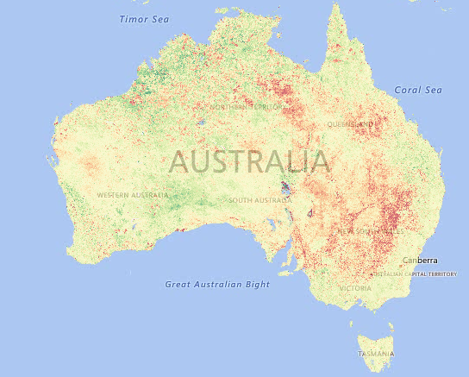
ows.go: func serveWMS()
serveWMS(ctx, params, conf, r.URL.String(), w)
This function delivers the data to the web request. There are several ‘request=XXX’ types, but in this document only the ‘GetMAP’ is described.
Layer
Time
Style
Req
Zoom
Data
Res
PNG
Map
Case GetMAP
utils/output_encoders.go: EncodePNG ()
processor/tile_indexer.go:NewTileIndexer()
processor/tile_pipeline.go: Process()
ows.go: Write(out)
utils/wms.go:GetCurrentTimeStamp()
processor/tile_pipeline.go: InitTilePipeline()
Sanity checks
utils/wms.go:GetLayerStyleIndex()
utils/wms.go:GetLayerIndex()
processor/tile_types.go:type GeoTileRequest()
case res := <-tp.Process(geoReq, *verbose):
res:
&{bare_soil [255 255 255 255 … -11.833333 255 255 … 256 255}
Scale the output as per the zoom factor.
scaleParams := utils.ScaleParams{
Offset: geoReq.ScaleParams.Offset,
Scale: geoReq.ScaleParams.Scale,
Clip: geoReq.ScaleParams.Clip,}
Value: {25 5 50}
norm, err := utils.Scale(res, scaleParams)
Value =1
if len(timestamps) == 0 { currentTime = time.Now().UTC() }
if ‘time=’ is not in the URL, then use the current time to get a blank image in the HTTP response instead of the 500 internal server error.
params.Time = currentTime
Create an object, ‘tp’, of type, ‘*processor.TilePipeline’ for displaying the tile.
Send the value of ‘geoReq’ to ‘func Process’ to get the data as a raster image (type []utils.Raster)
Send the following query to the MAS server to get the data.
http://10.0.1.210:8888/g/data2/tc43/modis-fc/v310/tiles/monthly/anomalies?intersects&metadata=gdal&time=2018...&until=2018...&srs=EPSG:3857&wkt=POLYGON((16.52 25.54,…))&namespace=bare_soil&nseg=2&limit=-1
Encode the x,y values in res into a raster image (PNG)
out, err := utils.EncodePNG(norm, styleLayer.Palette)
for x := 0; x < br[0].Width; x++ {
for y := 0; y < br[0].Height; y++ {
if br[0].Data[y*br[0].Width+x] != 0xFF {
canvas.Set(x, y, plt[br[0].Data[y*br[0].Width+x]])
}
}
}
product := params.Layers[0] for i := range config.Layers { if config.Layers[i].Name == product { return i, nil } }
Get the index of the requested layer in config.json. Error if none. e.g. layers=global:c6:monthly_anom_frac_cover
if conf.Layers[idx].ZoomLimit != 0.0 && reqRes > conf.Layers[idx].ZoomLimit {
out := utils/empty_tile.go:GetEmptyTile(utils.DataDir+"/zoom.png", *params.Height, *params.Width)
}
If the zoom level is low an image that says “zoom in to view this layer” is displayed.
Exit if the software version is not specified in the URL.
If the ‘time=’ is not in the URL, use the current time.
Exit if the CRS is not specified as e.g. srs=EPSG:3857
Exit if bounding box is not specified.
Exit if Height and Width are not specified.
Exit if Height and Width are too large.
Change BBox to float64 if CRS=EPSG:4326 and version is 1.3.0
Change CRS to EPSG:4326 if it is defined as CRS:84
Take the styles index from the URL (styles=&). If it is empty (default), the index is taken from config.json as the layer which is specified as &layers=global:c6:monthly_anom_frac_cover&
In geoglam/config.json idx=7. The string is case sensitive.
geoReq := &proc.GeoTileRequest{…}
This returns the params required to request the tile info from the MAS database.
geoReq:
&{{[bare_soil] 0xc42015ac80 {25 5 50} 0xc4201983e0 <nil> 10000 2 16 0 -1} /g/data2/tc43/modis-fc/v310/tiles/monthly/anomalies EPSG:3857 [1.62 -2.50 1.75 -1.25] 256 256 0 0 2018… +0000 UTC}
The data is sent back to the web for display.
Next:
CONCLUSION

Slide 6
CONCLUDING REMARKS
This is an overview of a very complex software, but not a tutorial.
Target audience:
New programmers to understand the system and modify.
Support personnel to get an insight.
End-users to know what goes underneath.
It is a quick alternative to reading the document that gives details.
There are minor gaps in this presentation and in the document.
They will be filled as more information is sourced.
DISCLAIMER
This is an evolving document and may go out of sync with the program in time. Those who maintain the program are requested to update this presentation and the document as well. While every effort has been made to make it easy to understand, not every line in the code is explained here. There may be gaps in my knowledge, which might have led to errors in the content, and they will be corrected as and when found.
Copyright © 2018 by NCI, Australia. Contact: Arapaut.Sivaprasad@anu.edu.au

